Slide 1

CLIX: AI-Driven Smart Utility Management System for Bangladesh
Presented by: CodeCrafters

Slide 2
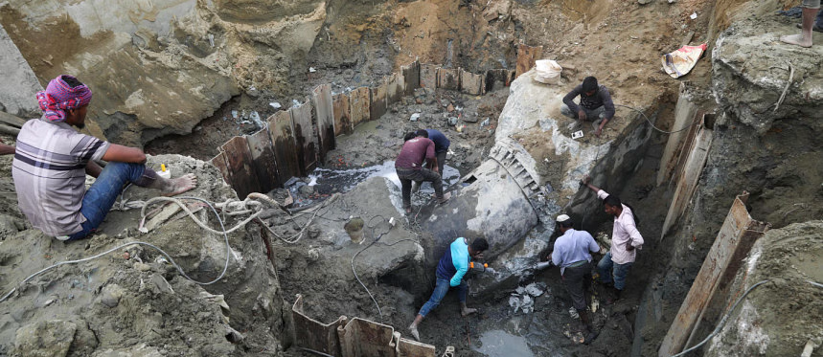
THE PROBLEM - CRITICAL INFRASTRUCTURE LOSSES

Slide 3
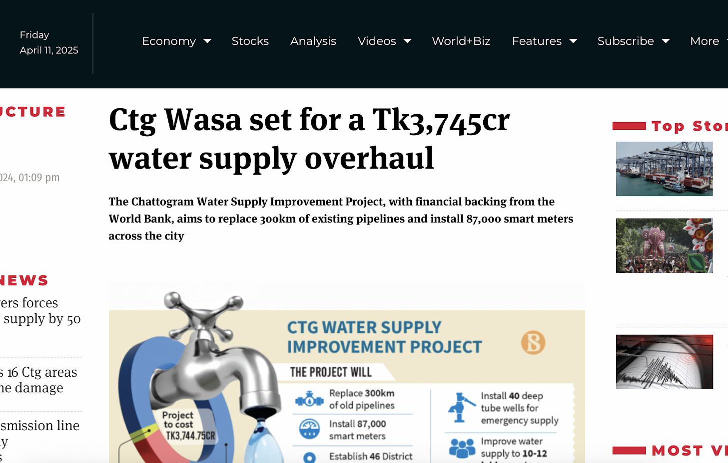
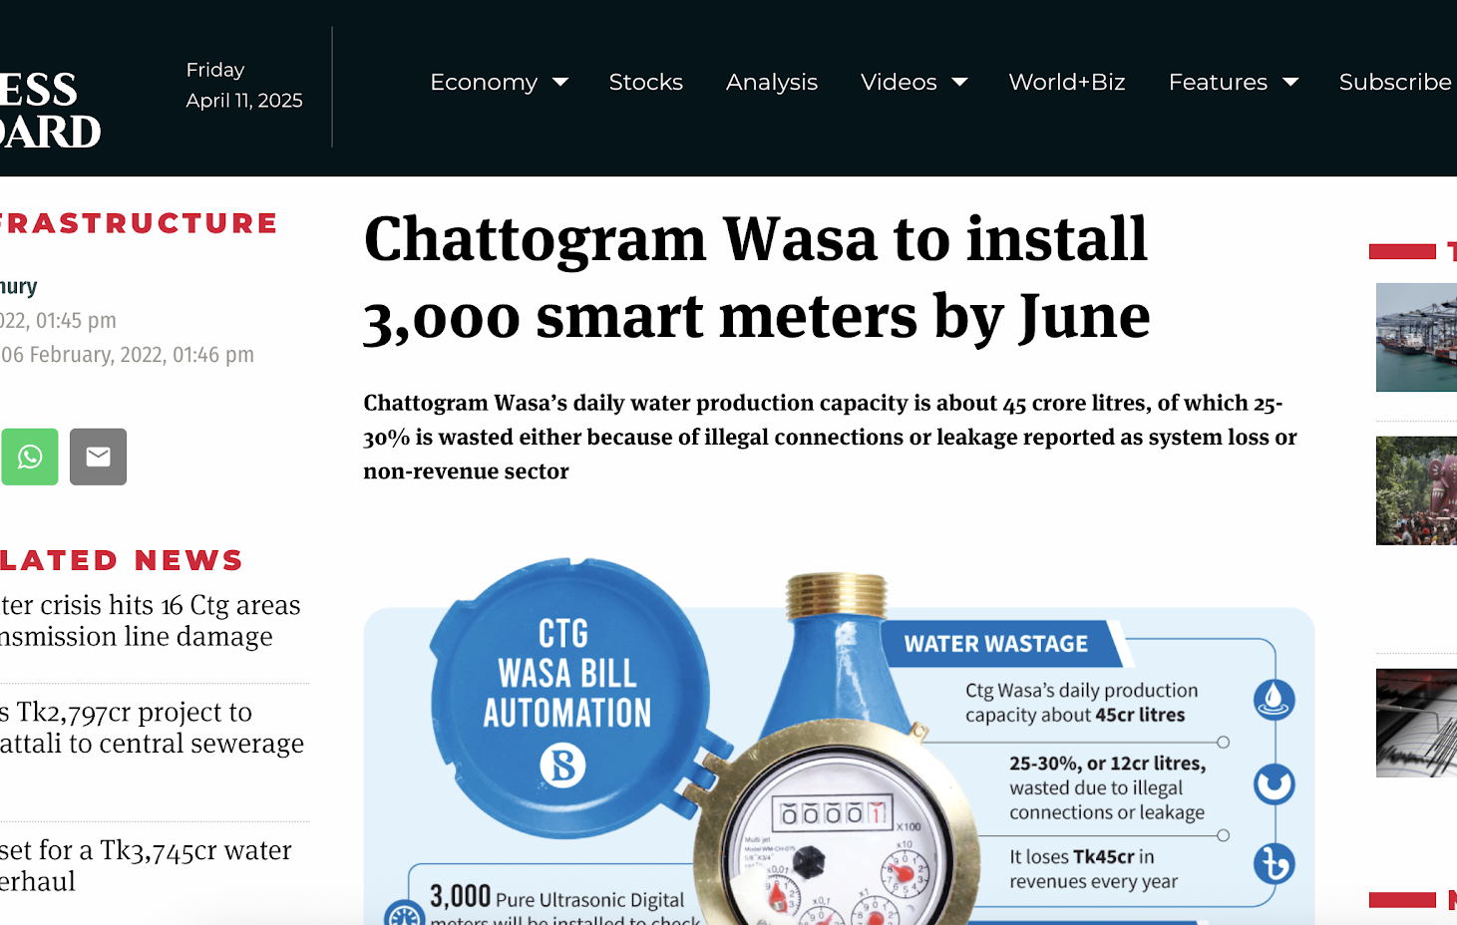
Water Supply Crisis
"Chattogram WASA experiences 25-30% non-revenue water loss, much higher than the global standard of less than 5%" (The Business Standard, 2024)
"A loss of Tk14-17 crore worth of water every month" (The Business Standard, 2024)
"42 Meter Inspectors for 78,000 connections" leads to inaccurate readings (The Business Standard, 2022)

Slide 4
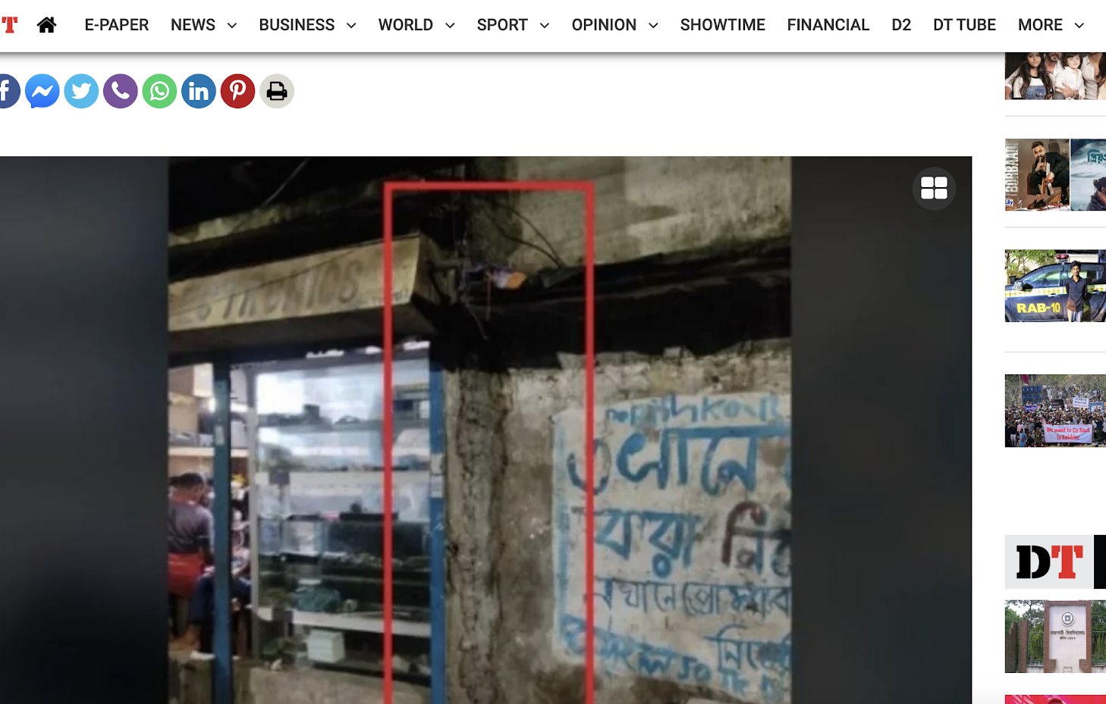
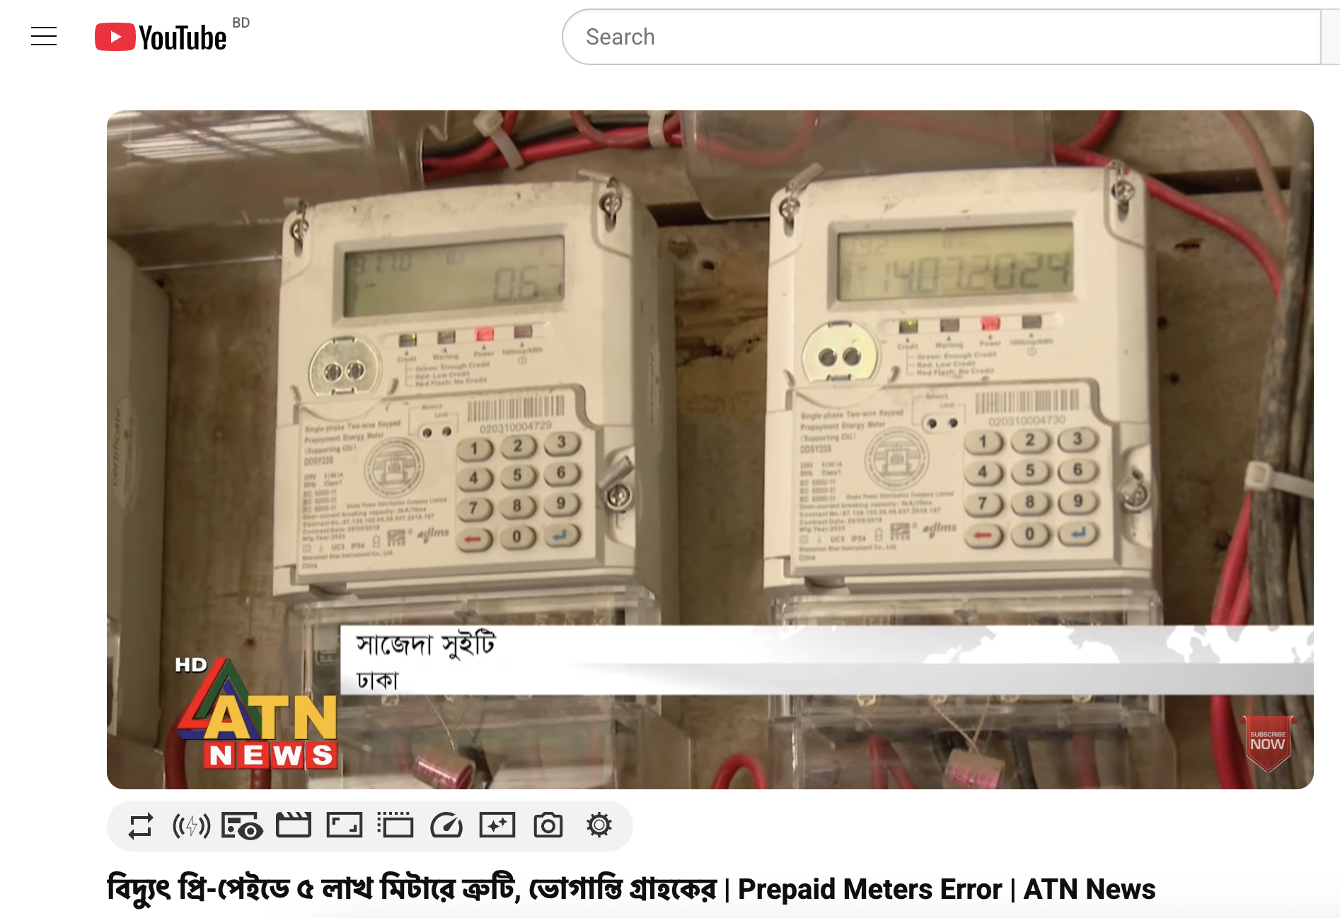
Electricity Distribution Failures
"5 lakh defective meters out of 3.5 crore" nationwide (ATN News - Jul 16, 2024)
Elderly users struggle with "token codes with over 100 digits" (CLIX exclusive interview)
"Four people were electrocuted when the power cable fell into the waterlogged area in Mirpur" (DhakaTribune, 2023)

Slide 5
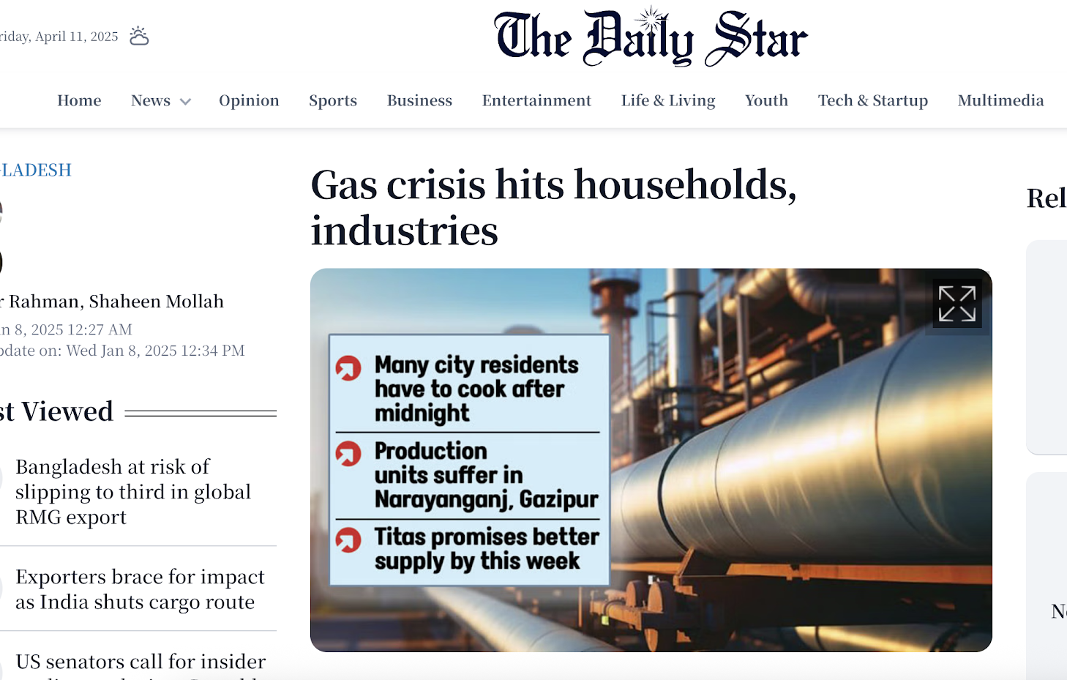
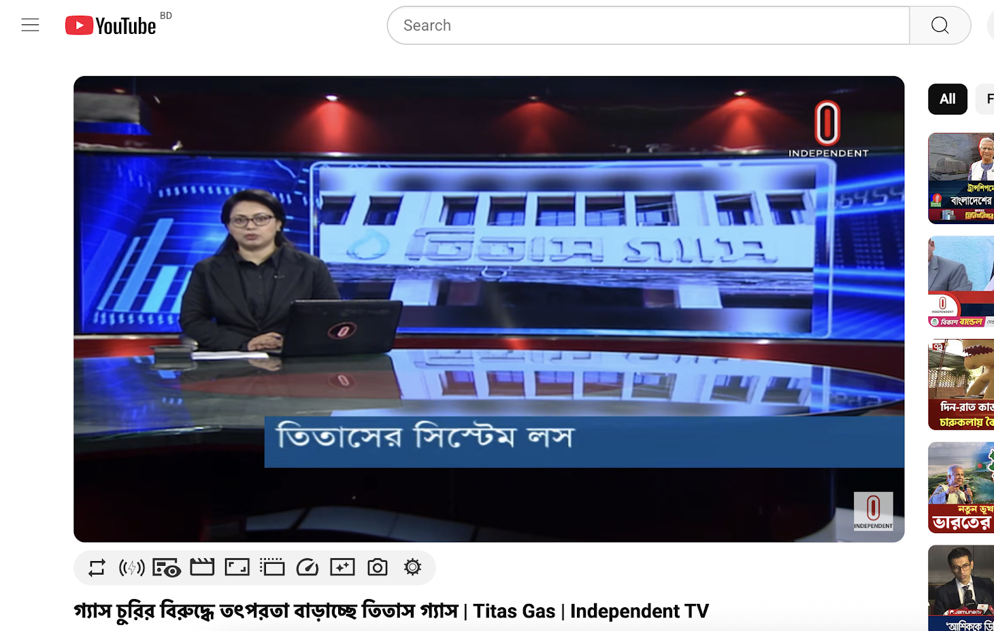
Gas System Inefficiencies
Titas Gas reported system losses of "7.67%, where BRC standardized 2%" (Independent TV, 2025)
Losses costing "3000 Cr BDT annually" (Independent TV, 2025)
Factories "cutting production by almost a third" due to inadequate gas pressure (Daily Star, 2025)

Slide 6
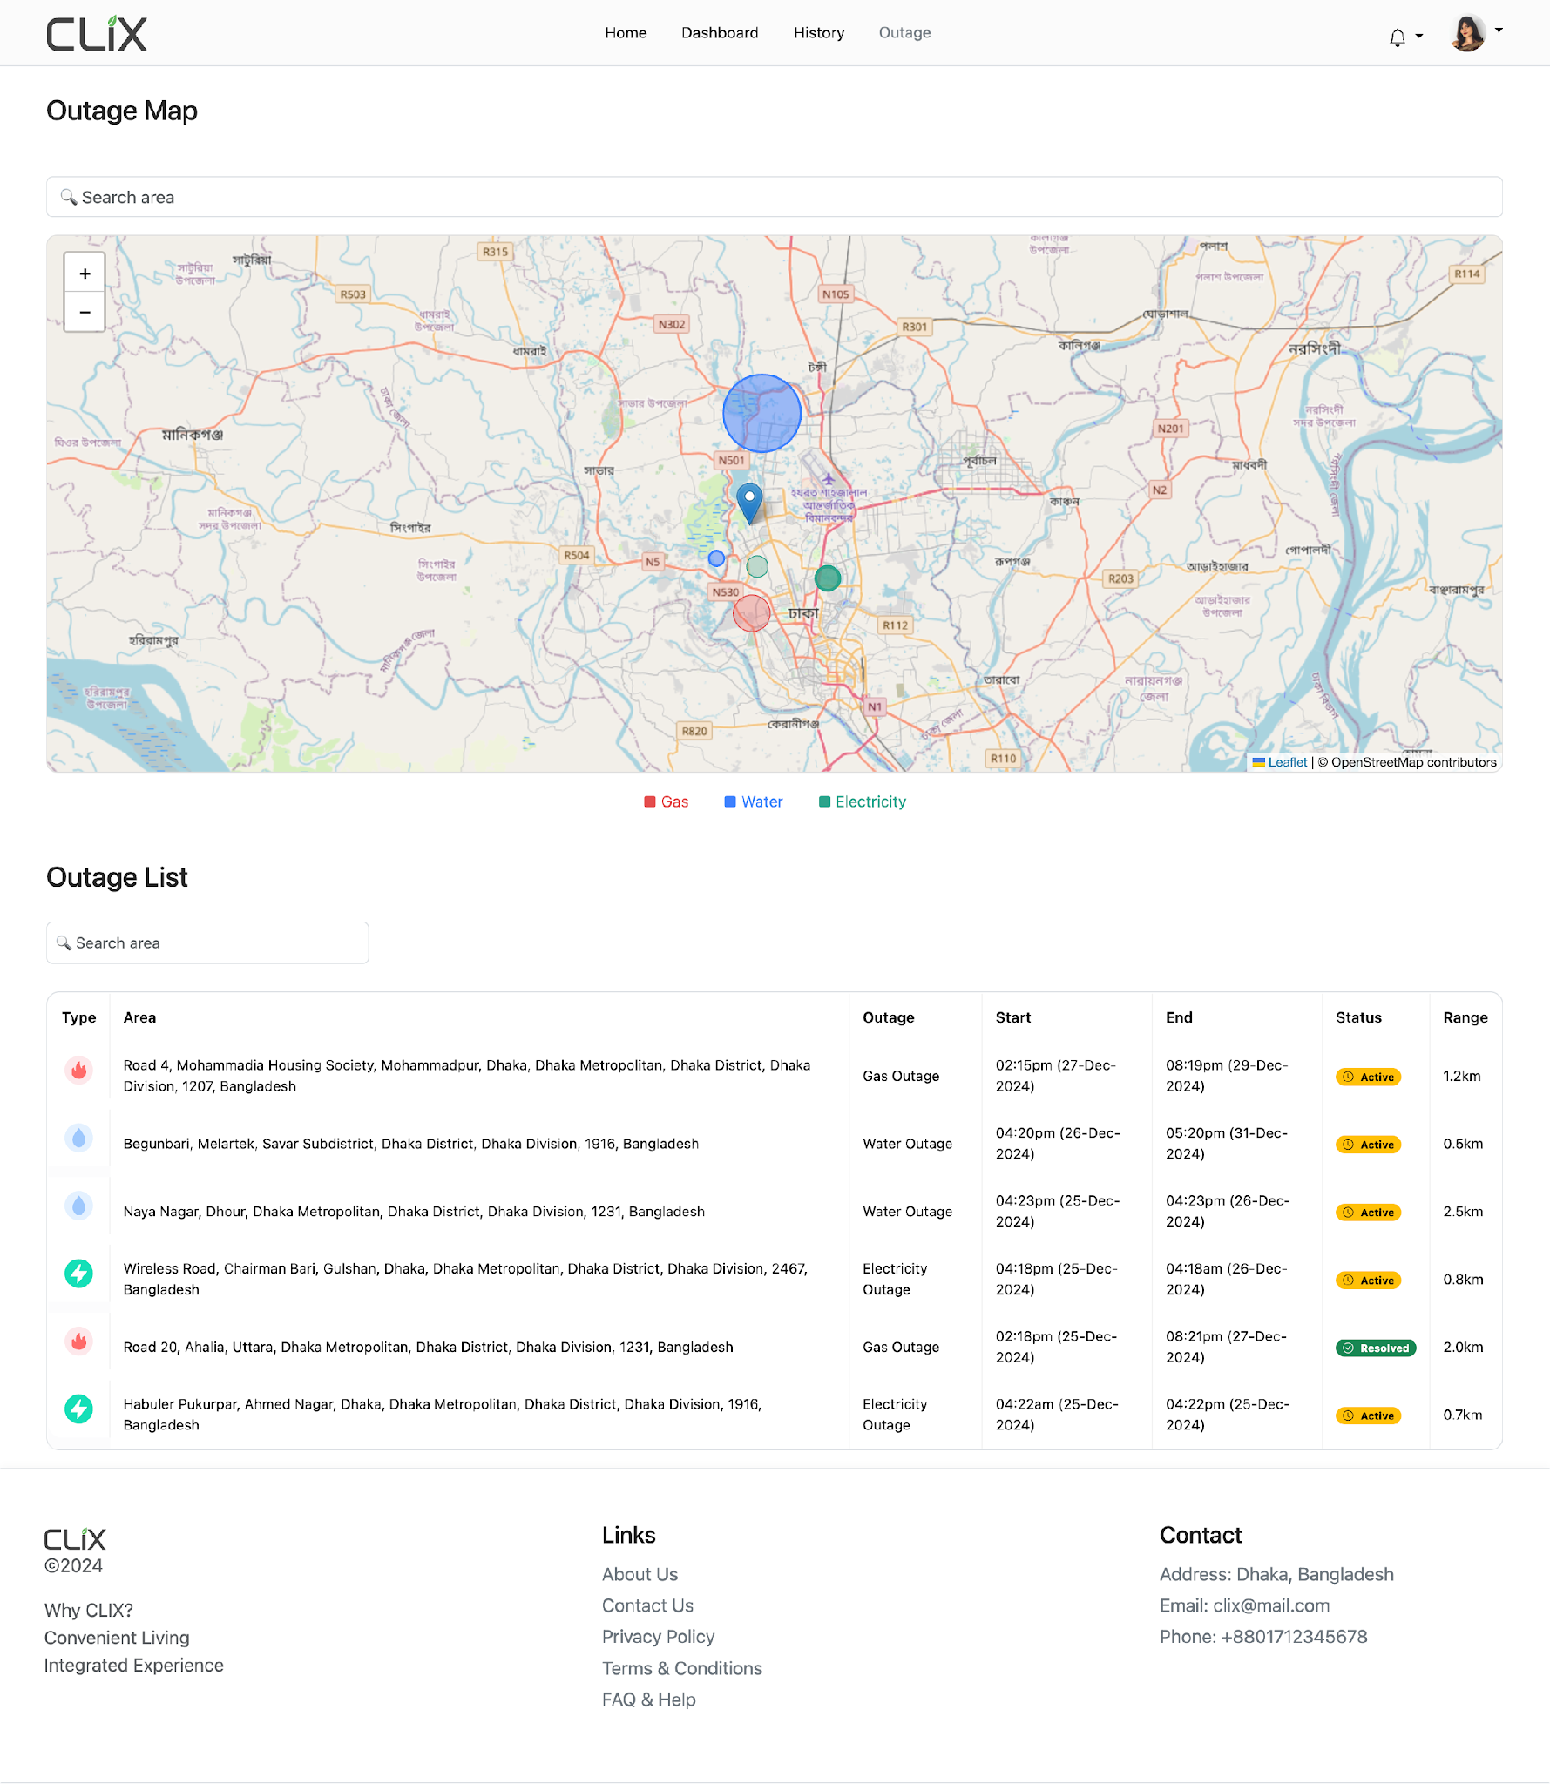
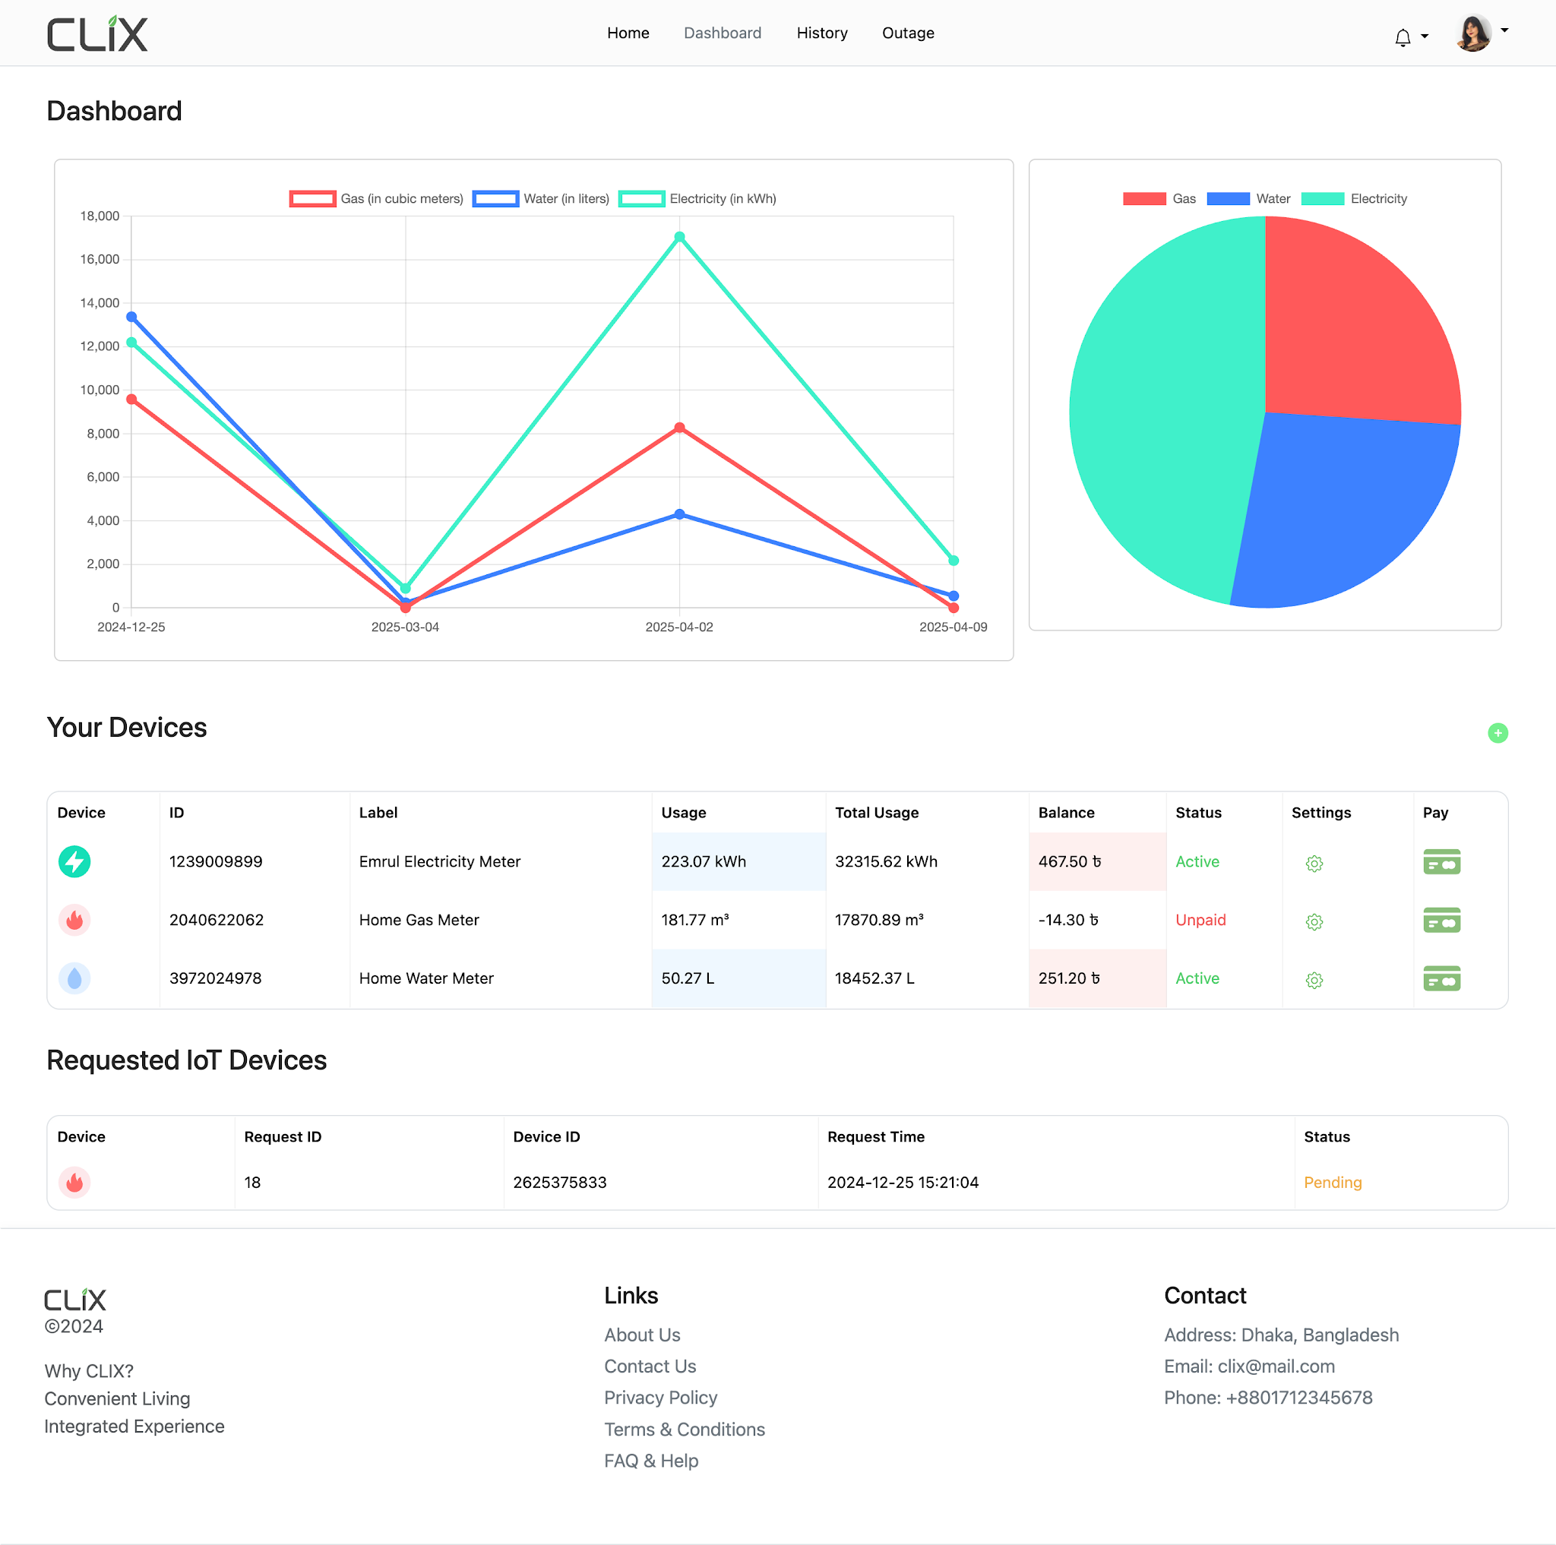
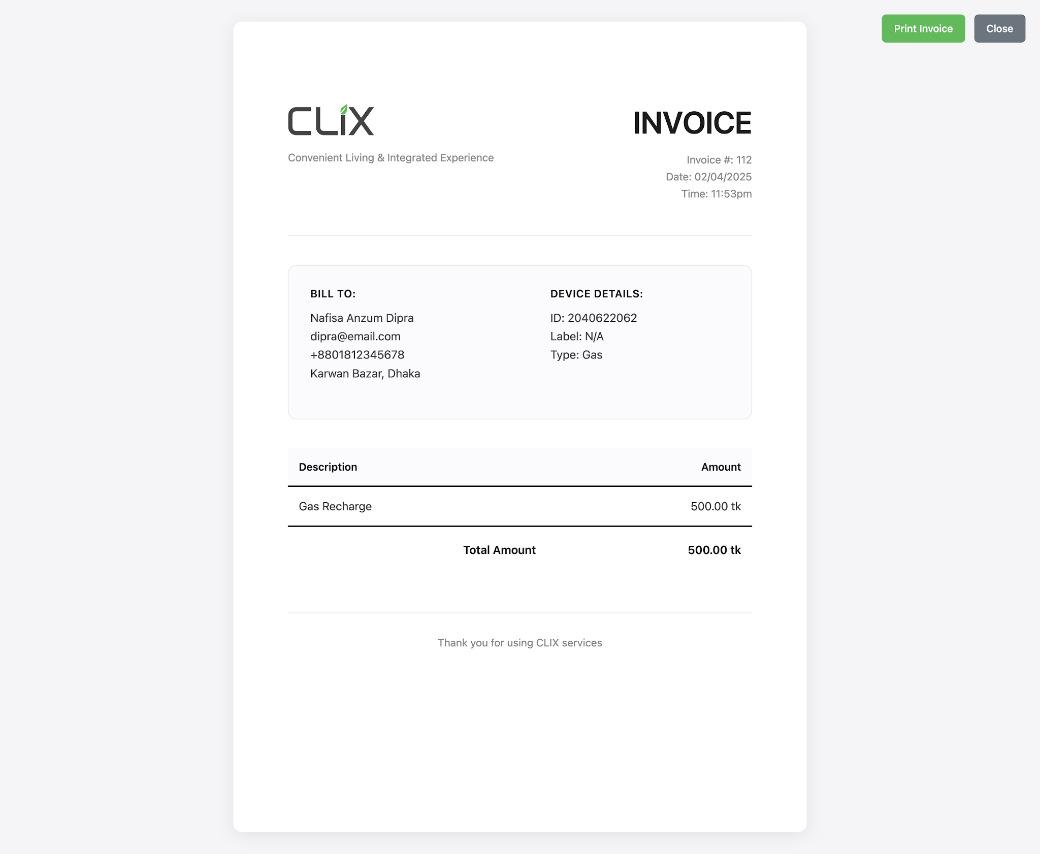
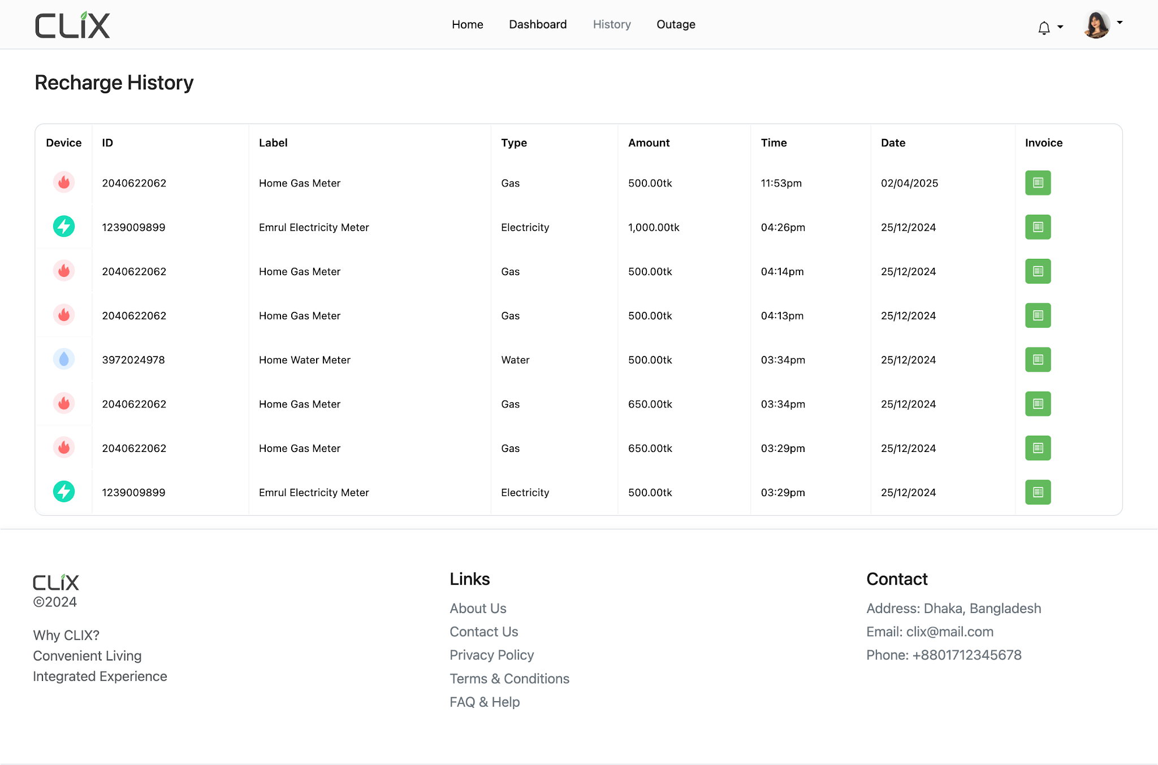
The Solution: CLIX (Convenient Living & Integrated Experience)

Slide 7
Dashboard

Slide 8
Outage Map

Slide 9
Recharge History

Slide 10
CLIX Overview
Integrated Technology Platform
LoRaWAN-enabled smart meters with tamper detection and AES-128 encryption
Unified management dashboard for real-time monitoring across all utilities
AI-driven analytics for:
  Leak detection
  Theft identification
  Equipment failure prediction
Multi-channel payment integration, including mobile banking
Real-time outage management with push notifications
Multi-language consumer portal with usage tracking
Key Objectives
Reduce non-revenue losses across all utilities
Deploy automated meter reading and billing systems
Enhance service reliability via predictive maintenance
Establish a unified platform for all utility operations

Slide 11

Now What is AND Why LoRaWAN?

Slide 12
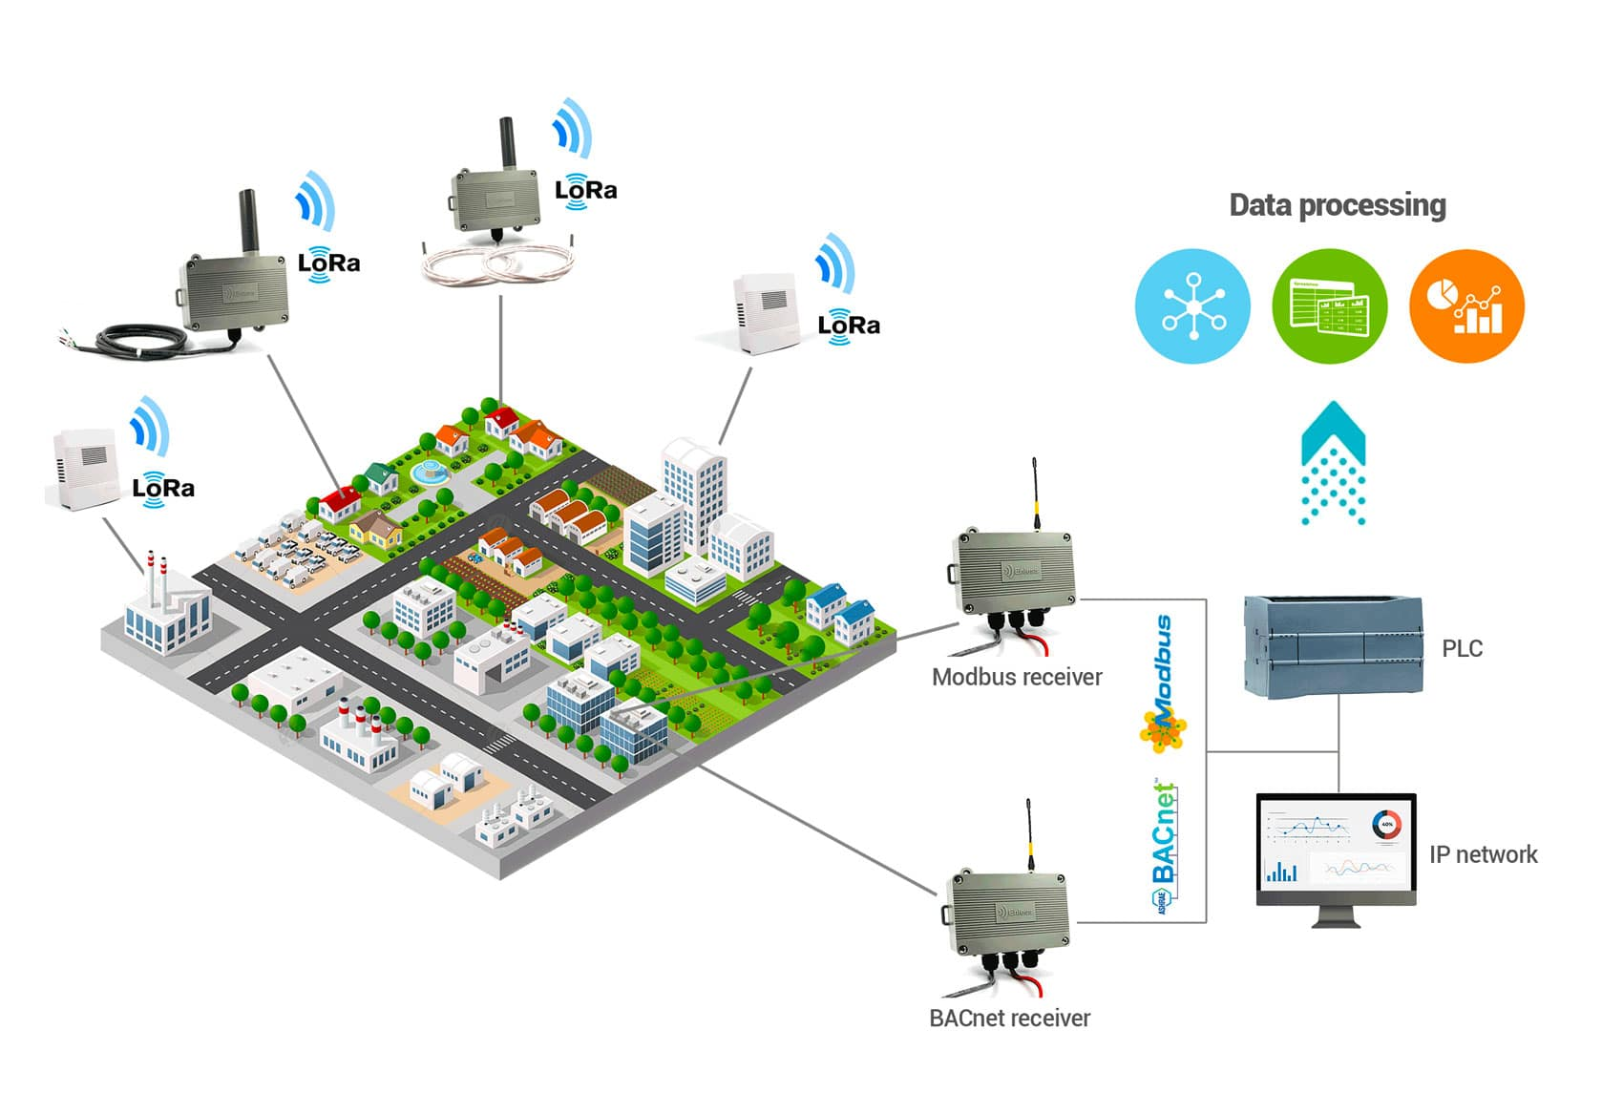
What is LoRaWAN?
Long Range Wide Area Network technology for IoT applications
Uses Chirp Spread Spectrum modulation for resilience
Long-range connectivity (10-15km) with minimal power consumption
Battery life of 7-10 years on a single charge
AES-128 encryption for secure end-to-end data protection
Operation on license-free spectrum, eliminating ongoing costs
Support for thousands of devices per gateway with minimal infrastructure

Slide 13
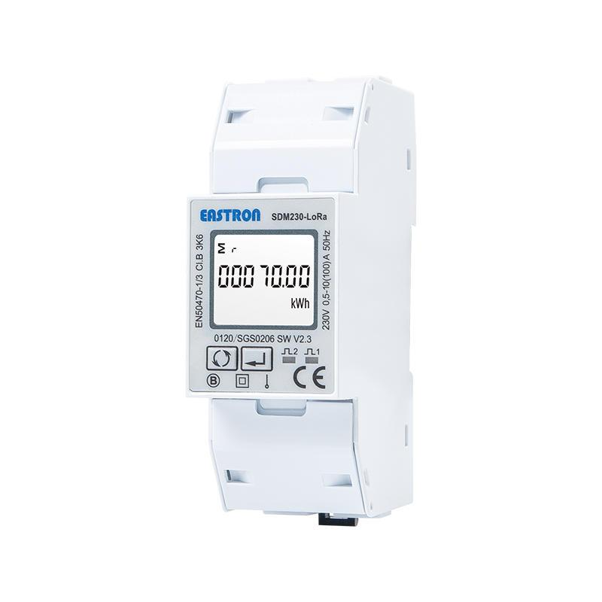
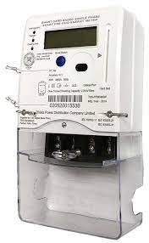
Technical Advantages of LoRaWAN
Current Challenges
5.72% losses in electricity. (DESCO Annual Report 2023)
Limited effectiveness of current GSM-based communication systems
Comparison with Current Systems:
Coverage: 10-15 km range vs. 1-2 km for GSM
Battery Life: 7-10 years vs. 2-3 years for GSM-based systems
Infrastructure: One gateway serves thousands of devices
Operating Costs: No ongoing SIM card or cellular data costs
Security: End-to-end encryption with AES-128

Slide 14
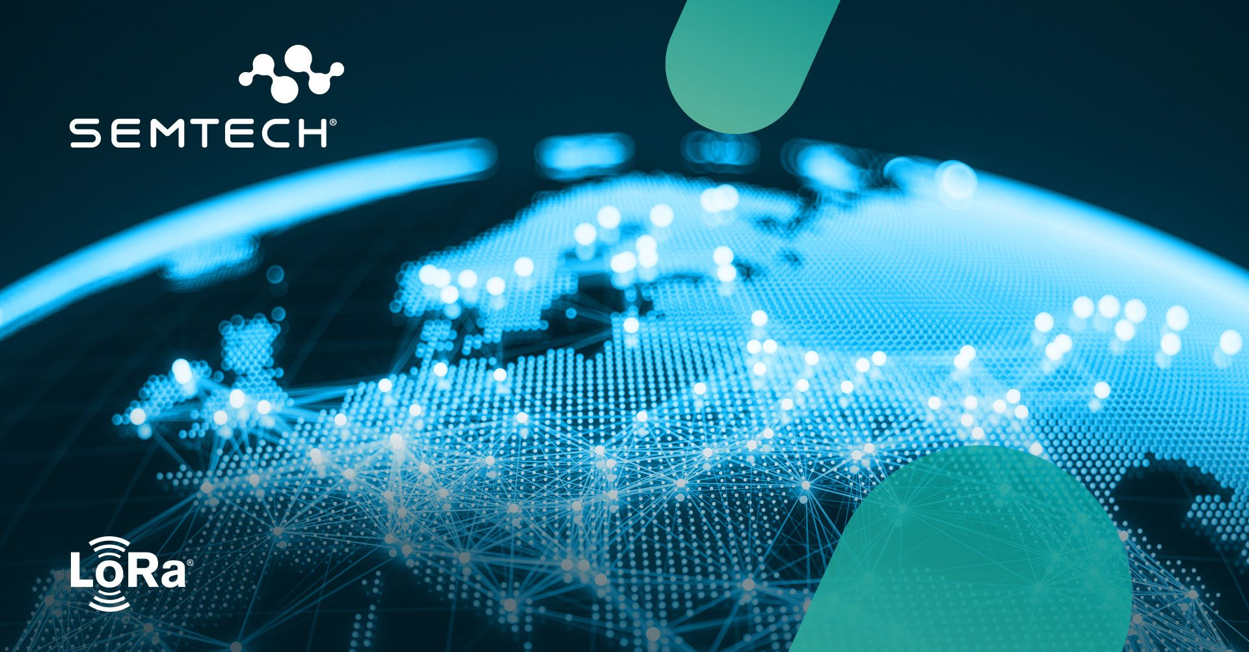
Global Evidence for LoRaWAN Effectiveness
Indonesia: Singapore-based Sindcon is retrofitting 50,000+ smart meters in Jakarta with STM32WLE5 LoRaWAN microcontrollers, enhancing remote meter reading in diverse environments while providing 10-year battery life. (The GPS Time, 2023)
Singapore: Sindcon achieved 90%+ data success rates and up to 7-year battery life with their LoRaWAN smart meters, significantly improving utility management efficiency. (Smart Energy, 2025)
Switzerland: Elvexys and Oiken implemented LoRa-enabled sensors for real-time power grid fault detection, reducing deployment costs by 90% compared to traditional methods. (Semtech, 2021)
France: CAHORS Group's Sentinel® line fault detection solutions use LoRaWAN to monitor power lines, enabling immediate fault identification and preventing costly outages. (Semtech, 2019)

Slide 15
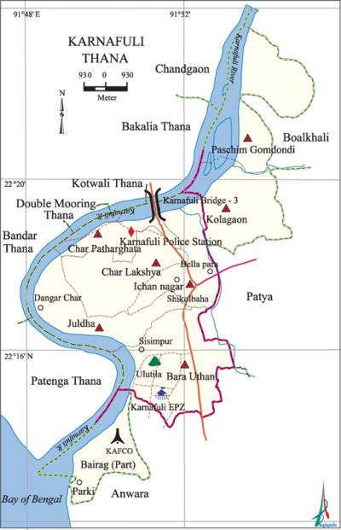
Proven Evidence of LoRa Success in Bangladesh
Chattogram WASA Pilot:
"3,000 Pure Ultrasonic Digital meters (LoRa)" already implemented (The Business Standard, 2022)
"With digital meters no one can tamper with it nor can steal. Also all the bills will automatically come to their server." (Md Samsul Alam, Deputy Managing Director, Chittagong Wasa – Independent TV)
Karnaphuli Water Supply Project:
Successfully "reduced non-revenue water to 10%" (The Business Standard, 2024)
"The Karnaphuli Service Area... with DMA system providing uninterrupted supply to 46,000 connections" (The Business Standard, 2024)
WASA Official Assessment:
"Hopefully, if the project is successfully implemented, water wastage will be prevented and Chattogram Wasa's revenue will increase." (Maksud Alam, Chief Engineer, The Business Standard, 2022)

Slide 16
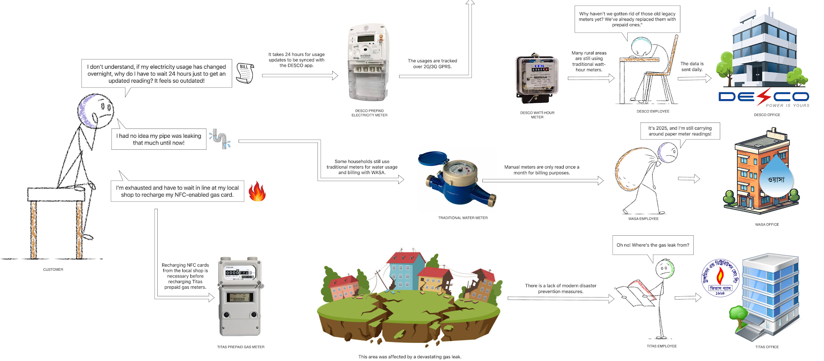
As Is System

Slide 17
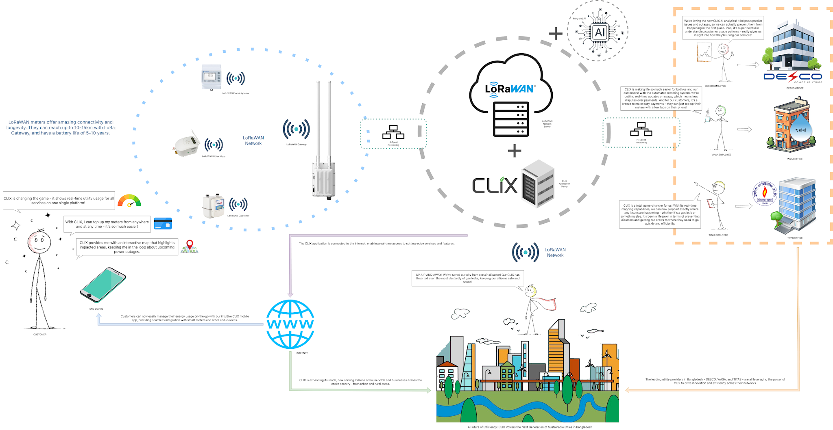
To Be

Slide 18
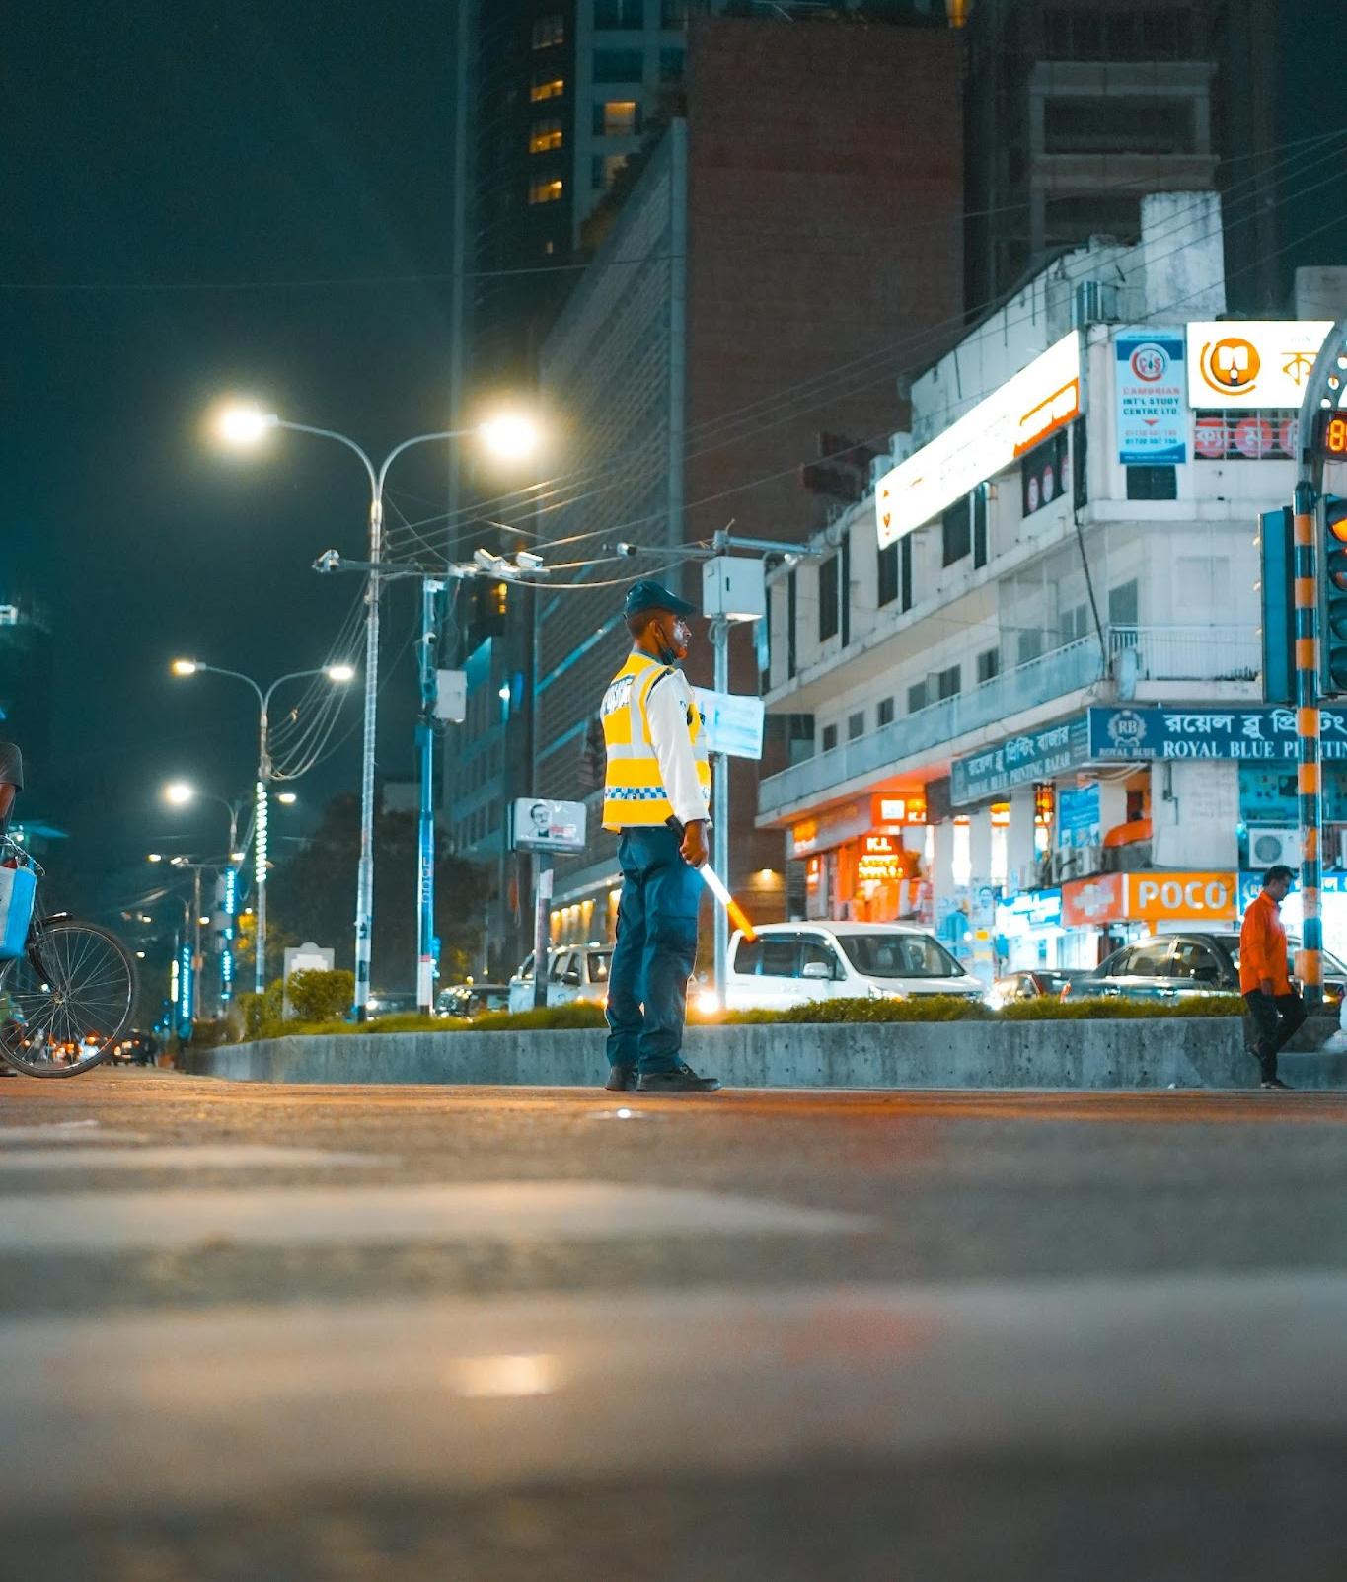
Market Size & Opportunity
Target Market:
40M+ households across Bangladesh
500K+ commercial and industrial entities
Addressing Critical Infrastructure:
Water supply networks serving major urban centers
Electricity distribution covering 3.5 crore connections
Gas utility systems with documented 7.67% losses
Corruption Elimination:
Evidence that "meter inspectors in collusion with WASA officials show less reading and provide illegal connections in exchange for illegal financial benefits" (The Business Standard, 2022)
CLIX removes human intervention points that enable corruption

Slide 19
Survey Analytics
Feature4 | Highly Helpful | Helpful | Neutral | Not Helpful | Not Helpful at all
Emergency gas leak alert at night | 88.60% | 10.10% | 0.00% | 0.00% | 1.30%
Real-time electricity bill tracking | 67.10% | 29.10% | 3.80% | 0.00% | 0.00%
Water leak alert when away from home | 70.90% | 27.80% | 1.30% | 0.00% | 0.00%
One-click bill payment via mobile | 74.70% | 24.10% | 1.30% | 0.00% | 0.00%
Preventing payment for others' illegal connections | 74.70% | 24.10% | 1.30% | 0.00% | 0.00%
Load-shedding timing notifications | 75.90% | 20.30% | 3.80% | 0.00% | 0.00%
Integrated system for electricity, gas, water | 65.80% | 27.80% | 6.30% | 0.00% | 0.00%
Tech & job opportunities from smart systems | 72.20% | 24.10% | 3.80% | 0.00% | 0.00%
Accurate billing with usage record | 75.90% | 17.10% | 6.30% | 0.00% | 0.00%
Disaster-time live utility map | 70.90% | 25.3% | 3.80% | 0.00% | 0.00%
Usage-based saving recommendations | 69.60% | 24.10% | 5.10% | 1.30% | 0.00%
Adoption of global smart utility models | 73.40% | 13.90% | 12.7% | 0.00% | 0.00%
Prior notification of utility personnel arrival | 65.80% | 22.80% | 10.10% | 1.30% | 0.00%
Knowing which appliances use the most electricity | 67.10% | 31.60% | 1.30% | 0.00% | 0.00%
Leaving reliable systems for future generations | 68.40% | 22.80% | 8.90% | 0.00% | 0.00%
Average | 72.07% | 23.00% | 4.65% | 0.17% | 0.09%
We collected 79 surveys (26 online, 53 offline). CLIX received "Highly Helpful" reviews from 72.07% of respondents, "Helpful" from 23.00%, "Neutral" from 4.65%, "Not Helpful" from 0.17%, and "Not Helpful at all" 0.09% of respondents.

Slide 20
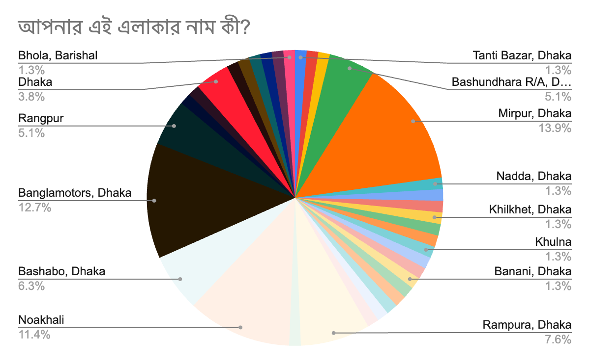
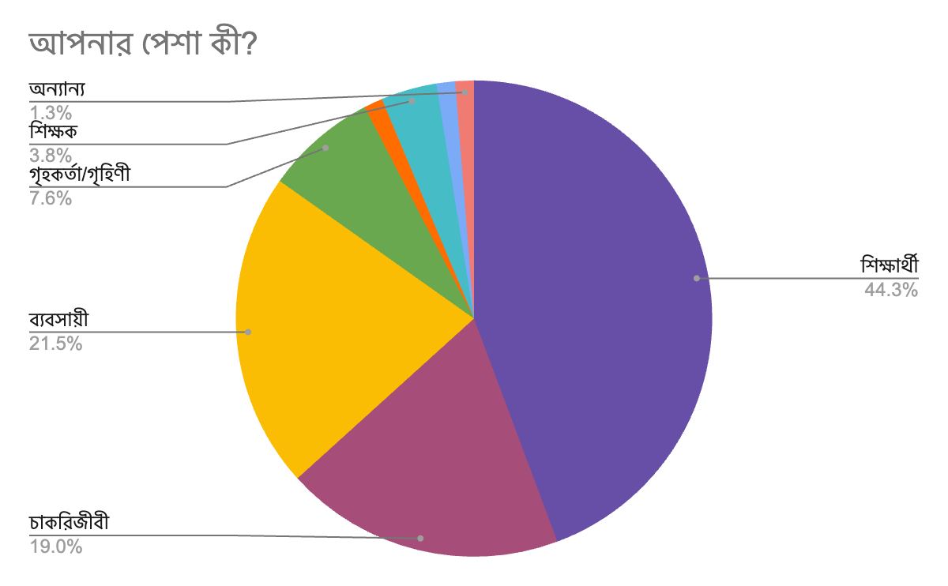
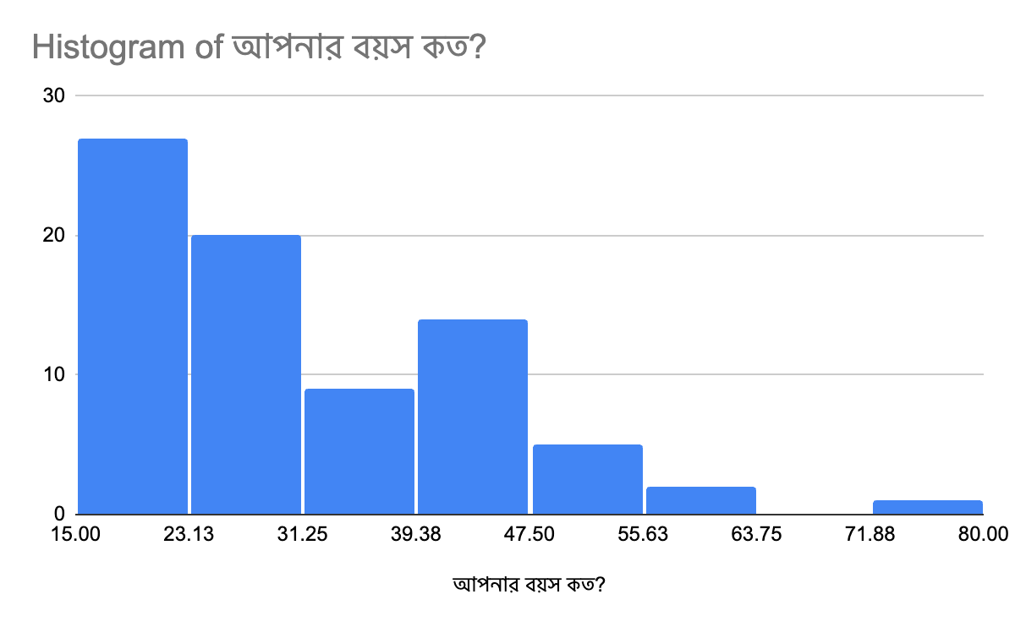
Survey Analytics
Occupation: 44.3% Student, 21.5% Businessman, 19.0% Service holder, 7.6% Householder, 3.8% Teacher & 3.8% Other
Area: Dhaka = 54.4% & Outside Dhaka = 45.6%
Age: 18-25: 35.4% (28 people), 26-35: 25.3% (20 people), 36-45: 19.0% (15 people), 46-55: 12.7% (10 people), 56-65: 6.3% (5 people) & 66+: 1.3% (1 person)

Slide 21
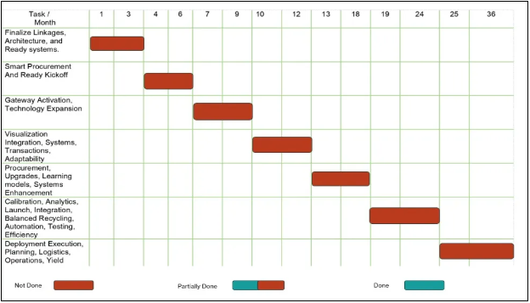
Implementation Plan
Comprehensive Project Lifecycle (36 months):
Research Phase (3 months): Needs assessment, regulatory compliance
Design Phase (4 months): System architecture, UI/UX, security protocols
Development Phase (6 months): Core components, integrations, analytics
Testing Phase (3 months): Quality assurance, security validation
Pilot Deployment (3 months): 5,000 households in selected urban area
Full Deployment (12 months): Phased rollout across regions
Maintenance & Enhancement (5 months): Ongoing support
Key Milestones:
Urban Deployment (Month 25): 100,000+ connections in major cities
Full Deployment (Month 31): Nationwide coverage
System Integration (Month 33): Complete integration with utilities
Performance Optimization (Month 36): System refinement

Slide 22
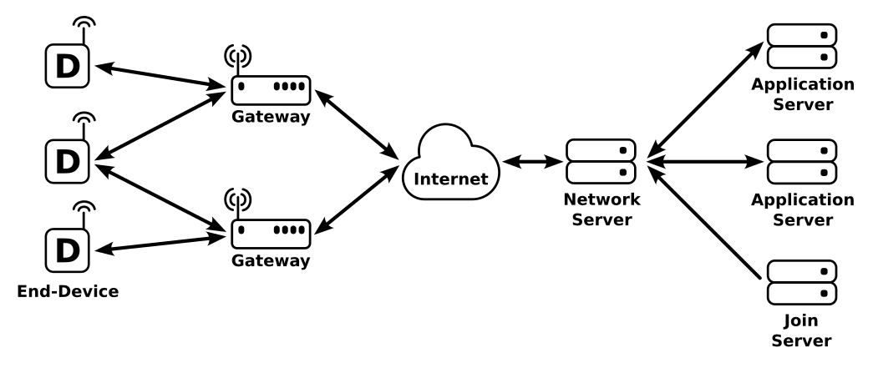
System Architecture
Core Components:
LoRaWAN-enabled Smart Meters:
  Tamper-resistant design with real-time monitoring
  AES-128 encryption for security
  Battery life of 7-10 years
  Examples include models like STK25MI gas meters
LoRaWAN Network Infrastructure:
  Carrier-grade gateways with 10-15 km range
  Hybrid connectivity options for reliability
  Mesh network capabilities for urban environments
Centralized Management Platform:
  Real-time dashboard for utility monitoring
  Outage mapping and management
  Payment integration system
  Analytics engine for pattern detection
User Interfaces:
  Mobile application for consumers
  Web portal for utility authorities
  API integration for third-party services

Slide 23
Comparative Analysis
Current System vs. CLIX System:
Key Improvements:
Non-revenue water loss reduction from 25-30% to 10%
Elimination of 5.72% electricity distribution losses
Minimization of 7.67% gas system inefficiencies
95% detection accuracy for unusual consumption vs. <30% in current systems
Average payment time reduced from 45 minutes to under 2 minutes
Feature | Current System ("As Is") | CLIX System ("To Be")
Meter Reading | Manual, once per month | Automated, real-time
Usage Updates | 24-hour delay | Instant monitoring
Fraud Prevention | Vulnerable to collusion | Tamper-resistant design
Payment System | Physical visits required | Remote mobile payment
Consumer Visibility | Limited insight | Detailed analytics
System Integration | Siloed utilities | Unified platform

Slide 24

REVENUE Model
Customer-Based Revenue: Utility providers will share a portion of their revenue with CLIX.
Enterprise-Based Revenue: CLIX will provide advanced monitoring systems to enterprise users. These users will pay utility providers, and CLIX will receive a share of this revenue. Additionally, CLIX will earn income through subscription fees.

Slide 25
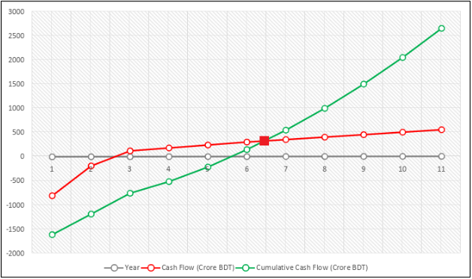
Economic Feasibility
Investment Overview:
Total project cost: 1420.55 crore BDT
Initial investment: 566.5 crore BDT
10-year maintenance costs: 675.0 crore BDT
Contingency (10%): 129.05 crore BDT
Financial Metrics:
Net Present Value (NPV): 448.73 crore BDT
ROI: 87.95%
Payback Period: 5.44 years (5 years, 5 months)
Total Cash Inflow over 10 years: 2670 crore BDT
Net Benefit: 1249.45 crore BDT

Slide 26

SUSTAINABILITY
Economic Benefits:
50% reduction in manual meter-reading expenses
15-20% reduction in utility waste (20-25 crore BDT annually)
50-60 crore BDT in annual energy cost reductions
Environmental Benefits:
CO₂ emission reduction: 1.5 million tons per year
Water conservation: 2-3 billion liters annually
Social Benefits:
Job creation: 20,000-50,000 new positions
60% reduction in unplanned outage duration
40% fewer billing disputes

Slide 27

Why Invest in CLIX
Building on proven success of Chattogram WASA's smart meter pilot
Comprehensive implementation plan with clear milestones
Multiple revenue streams ensuring long-term sustainability
Key Impact Quote: "We are losing more than Tk45 crore in revenue every year [just in Chattogram]. WASA officials hope that digital meters can prevent this wastage and corruption." (The Business Standard, 2022)

Slide 28

Thank You
"The people who are crazy enough to think they can change the world are the ones who do." - Steve Jobs

